Slide 1

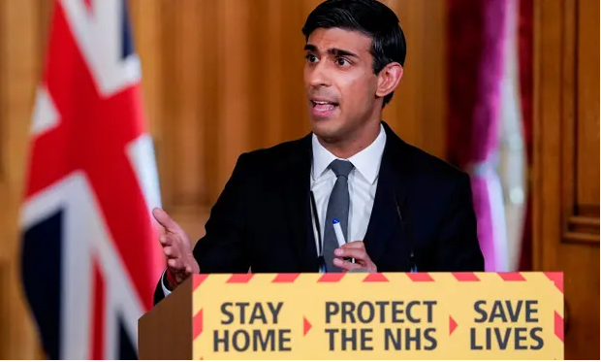
Economics Project
A project for Year 11
Written by: The Economics Team at Woking college

Slide 2
Instructions
Please play powerpoint slides in ‘show’ mode so that embedded clips can be played
The £ sign top left indicates the level of difficulty:
£ GCSE standard
££ Intermediates standard
£££ A level standard
3. If you want further help or feedback, please contact the economics team at Woking College:
Steve Green sgr@woking.ac.uk
Anne Jackman aja@woking.ac.uk
Michelle Phillpotts mph@woking.ac.uk

Slide 3
Project Title
Outline the economic effects of the corona virus (covid-19) on both the UK and world economies in the short and long term. What should the future world economic order look like?
1,500-2,000 words

Slide 4
Guidance on whole Project
Please write in report style with a contents page, headings, sub-headings and numbers and / or bullet points
Include any tables, charts, diagrams or other images, either in the appendix or in the main body of the report. These will not contribute to the word count
Include a bibliography at the end, showing all the sources that you used, including web-sites visited
Please ensure that all pages are numbered

Slide 5
Economics words to use
££
Unemployment, poverty and universal credit
Price rises (inflation)
National output (GDP)
Standard of Living
Exports and Imports
Taxes and Tax relief
Government spending including subsidies
Business costs
Government legislation (Acts of Parliament)
Less Economically Developed Countries (LEDCs)

Slide 6
Structure of Project
Contents page
Introduction
Economic Effects | UK Economy | World Economy
Short term (< 1 year) | 3 | 5
Long term (> 1 year) | 4 | 6
What should the new world economic order look like?
Summary and Conclusions
Bibliography
Appendix (optional)

Slide 7
2. Introduction
In the introduction you want to ‘set the scene’ by explaining what the project is about and how you are going to tackle it.
You need to give a background to the pandemic
It is useful to continually use ‘Who?’, ‘When?’, ‘Why?’, ‘Where?’, ‘What?’ and ‘How?’
Explain, briefly, the significance of the pandemic to the UK and world economy – use key statistics
Get the reader interested and wanting to read more but, make sure that you don’t answer the question in the first paragraph!

Slide 8

2. Introduction
£
Listen to podcast giving an overview of the project:

Slide 9
3. Short-term effects on UK
£
In economics, even in a crisis, there are some sectors of the economy that will perform better than others
Look on the next slide to see a list of those businesses that will increase sales and profits during the corona virus and those who will suffer. Can you think of any more?
Which business sectors and geographical regions will experience the greatest rise in unemployment?
Will there be any business sectors that see a growth in employment?

Slide 10
3. Short-term effects on UK
£
Businesses or parts of the economy that are likely to increase sales and profits | Businesses or parts of the economy that will see a significant fall in sales and profits
Gaming industry | Air travel
DIY / Gardening | Restaurants
Home exercise equipment | Clothes retailers
Home office equipment | Hotels
Board games / puzzles / books | Bars / Pubs / Coffee shops
Corner shops | All sporting clubs
Home cooking | Other Events / Festivals

Slide 11
3. Short-term effects on UK
££
Behavioural economics looks at the psychology of consumer behaviour
Why did people hoard food before lockdown?
Why did people gather in parks and on beaches before lockdown?
How has the government used advertising and slogans to influence behaviour (protect the NHS, save lives, stay at home, daily media briefings)
How effective has this been in influencing how we behave?
Was there a better way – such as taxes?

Slide 12
3. Short-term effects on UK
£££
What will be the short-term effect on the UK economy in terms of economic output (GDP) and growth?
What will happen to interest rates?
What will happen to tax revenue if fewer people are working and fewer people are spending?
What will happen to the demand for universal credit?
How will the government be able to finance increased spending with fewer tax receipts?
What will happen to prices? What has happened to the price of petrol?

Slide 13
4. Long-term effects on UK
£
Will factories, offices, restaurants and shops be open for longer hours in 2021 to catch up for lost production?
Will some professional sports clubs and restaurants / hotels close down. Will airline companies make staff redundant?
Can unemployed waiters be re-trained as delivery drivers or makers of home leisure equipment?
Will there be a jump in the birth rate in 2021 following the lockdown period in 2020?

Slide 14
4. Long-term effects on UK
£££
If unemployment rises, will wages fall?
What will happen to consumer confidence and spending?
What will happen to business investment?
What will happen to prices?
What will happen to the standard of living?
What will happen to Government borrowing and the national debt?
How long before output returns to levels before the corona virus in February 2020

Slide 15
5. Short term effects on world economy
££
Threats to world economy | Opportunities for world economy
Global recession | Less pollution
Countries that export commodities suffer from falling world prices | Reversal of global warming?
Fewer trade deals with Less Economically Developed Countries (LEDC’s) | More wildlife visible
90% of the world’s countries will see income per head falling | Stronger sense of community with less pressure and stress?
Higher levels of debt in all countries which will affect future generations | More simple and healthier home cooking and a better quality of life?
Anything else? | Anything else?

Slide 16
6. Long term effects on world economy
££
Threats to world economy | Opportunities for world economy
Slump in world economic activity for several years. | A chance to reflect, re-structure and re-set.
High unemployment and civil unrest due to greater poverty and inequality. | More working from home and less commuting and less congestion.
Alternatively, during 2021, the world may catch up through over production but this may cause spikes in global pollution. | More sustainable economic activity, less movement around the world and more virtual communications. Less pollution.
Vulnerable groups and LEDCs suffer the most from the global ‘downturn’ in years to come. | The world economies realise their interdependence and work in greater harmony, supporting each other.

Slide 17
7. What should the new world economic order look like?
£
Greater awareness that we all depend on each other. If someone coughs in Wuhan, China then eventually someone in Woking, UK will get ill.
How can the rich countries of the world help the poor countries of the world?
Can we work as effectively from home for one or more days each week? This will help pollution and congestion
Is the ‘quality of life’ more important than economic prosperity?

Slide 18
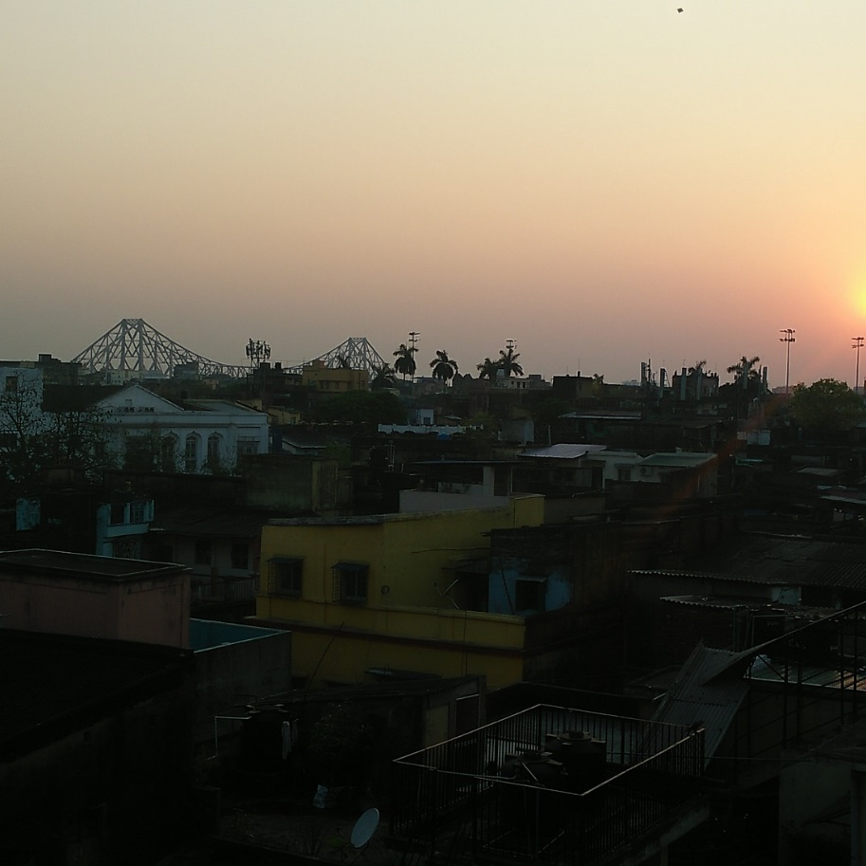
7. What should the new world economic order look like?
As a result of the ‘lockdown’ of production, there has been a significant fall in global pollution. People in Beijing were able to see blue sky, people in Venice were able to see fish in the canals and many people living in mega cities in Asia were able to see sunsets for the first time. The picture on the right was taken from a roof-top during lockdown in Kolkata (Calcutta) in India. It shows a sunset which many young residents of the city had never seen before due to excessive air pollution before lockdown.

Slide 19
8. Summary and Conclusions
Draw together all the main points that you have made in your project with a series of sentences – one for each main point
Emphasise anything new that you have learnt and which is important
What conclusions have YOU drawn from undertaking this project
What new world economic order would YOU like to see?

Slide 20

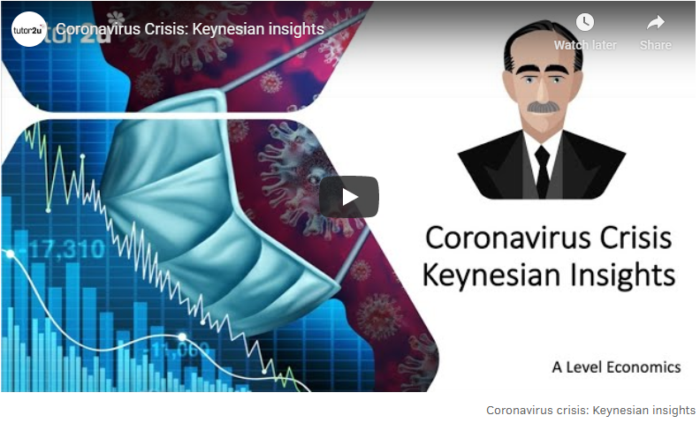
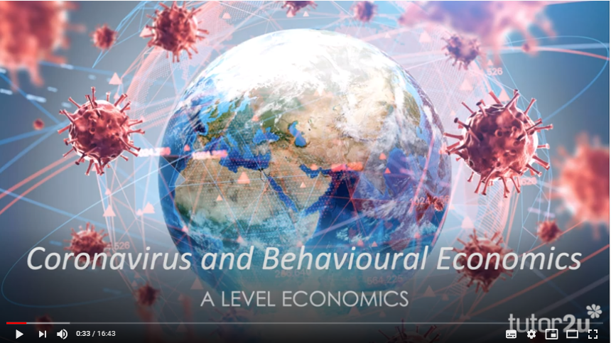
9. Bibliography
Click on any of the three slides shown on the right to find out more about A level economics and the corona virus. You can use these for sources of information for your project.

Slide 21
9. Bibliography
Click on any of the links below for further information:
BBC News:
https://www.bbc.co.uk/news/business/economy
The Times Newspaper:
https://www.thetimes.co.uk/topic/economics?page=1
The Bank of England:
https://www.bankofengland.co.uk/coronavirus

Slide 22
9. Bibliography
Click on any of the links below for further information:
The IMF (International Monetary Fund):
https://www.imf.org/en/Topics/imf-and-covid19
The OECD (Organisation for Economic Cooperation and Development:
http://www.oecd.org/coronavirus/en/
HM Treasury (UK Government)
https://www.gov.uk/government/organisations/hm-treasury

Slide 23
The End!

